Slide 1
Progress of Integrated Care Systems: The Harrow Borough Based Partnership
Lisa Henschen, Managing Director, Harrow Borough-Based Partnership

Slide 2
Overview and context
The purpose of this presentation is to provide an update to the Harrow Health Scrutiny Committee on the progress of the Harrow Borough Based Partnership in the context of the wider development of the Integrated System developments.
The Health and Care Act Legislation has been delayed and the Integrated Care Partnership and Integrated Care Board are now expected to be established as Legal Entities on 1st July 2022. North West London’s position is that we should continue our work to set up our new systems at pace, and operate in shadow form in advance of the formal changes in July.
Aligned to this, the ICS has commenced work to develop its strategy for the next three years and action plan for the next year. Critical to this work is the role of Borough-based Partnerships in these new arrangements and Harrow will be involved in this development process.

Slide 3
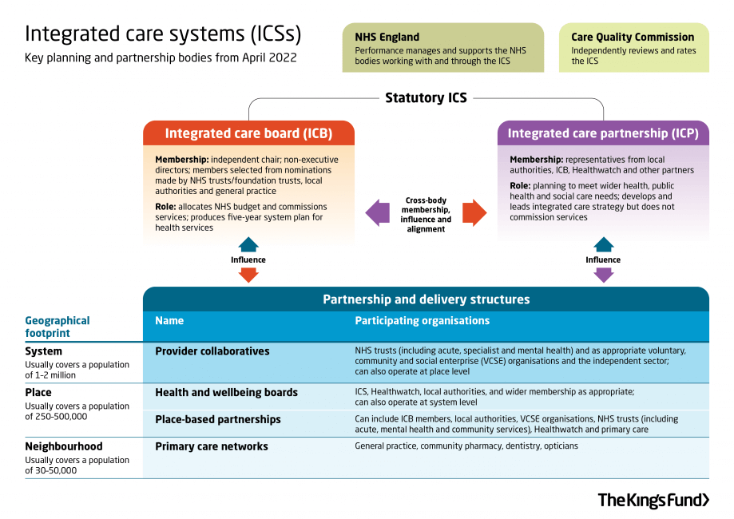
Integrated Care: the national context
ICSs have been developing for several years – the Health and Care Bill will put them on a statutory footing from April 2022 (subject to any amendments to the Legislation as it passes through Parliament).
The statutory ICS will be made up of two key bodies:
Integrated care board (ICBs) will take on the NHS planning functions previously held by clinical commissioning groups (CCGs) and are likely to absorb some planning roles from NHS England. ICBs will have their own leadership teams, which will include a chair and chief executive, and will also include members from NHS trusts/foundation trusts, local authorities, and general practice, selected from nominations made by each set of organisations.
Integrated care partnerships (ICPs) will operate as a statutory committee, bringing together the NHS and local authorities as equal partners to focus more widely on health, public health and social care. ICPs will include representatives from the ICB, the local authorities within their area and other partners such as NHS providers, public health, social care, housing services, and voluntary, community and social enterprise (VCSE) organisations. They will be responsible for developing an integrated care strategy, which sets out how the wider health needs of the local population will be met.

Slide 4
The Harrow Integrated Care Partnership
Harrow Integrated Care Partnership (ICP) brings
together our NHS organisations, Harrow Council,
our GPs, and local Voluntary & Community Sector.
We strive to support each
other and our communities as
equal partners focussing on
better health and wellbeing for all.
NHS North West London Clinical Commissioning Group
Harrow Council
Harrow’s Primary Care Networks
NHS Central London Community Healthcare NHS Trust
NHS Central and North West London NHS Foundation Trust
NHS London North West University Healthcare
Harrow Community Action
Harrow Health Community Interest Company
St Luke’s Hospice

Slide 5
ICP Governance Structure
Decision making
Statutory Body
Provider Boards
ICS
Staff advisors
Citizen advisors
Harrow Joint Management Board
Integration operational leads team
Harrow Health and Care Executive
Harrow Health and Social Care Senate
Neighbourhood integration function (x 5 PCNs)
ICP Transformation workstreams
Health Overview and Scrutiny Committee
Council Cabinet
Health and Wellbeing Board

Slide 6
Decision-making Structure in the Harrow ICP
Sovereign Organisational Governance and Decision Making
Local Authority
Provider Boards
ICS
Primary Care Networks
Harrow Community Action
St Luke’s Hospice
Harrow Health CIC
Agreed level of delegated responsibility
Harrow Joint Management Board
Agreed level of delegated responsibility
Harrow Health and Care Executive

Slide 7
ICP Transformational Workstreams
Delivery Workstreams
Population health management & Tackling Health Inequalities | Prevention, self-care and social prescribing sub-group
 | Tackling health inequalities sub-group
 | Population health management working group
Long term conditions
Mental Health
Learning Disability and Autism (all age)
Frailty and care settings
Children and Young People
Carers
Enabling workstreams
Workforce and OD integration
Access to care and COVID recovery
Strategic Estates Group
Digital transformation
Communication and engagement
Integration Operational Leads

Slide 8
Progress of the partnership: Pandemic response
In responding to the Omicron variant, the Harrow partnership once again came together to face this collective challenge and respond to protect our residents, ensure safety and continuity of core services as well as ensuring that the health and care system continued to function. Business continuity plans that were well developed were enacted and we met as a partnership to understand impact, problem solve and maintain system oversight. Key areas of our partnership response were:
Vaccinations | Harrow has delivered over 465,000 vaccinations (first, second and booster doses), this equates to approximately 72% of residents having their 1st dose and has one of the highest uptake rates across NWL. Over the coming weeks there will be an increased focus on hyper local approaches to engagement with residents and communities in which there are low vaccination uptake.
Managing urgent care demand | Primary care services remained open and responsive to their Practice populations over this period. In addition, the NHS Winter Access Fund was implemented in Harrow to increase access to urgent care services and prevent acute admissions. Harrow Health has established streaming at the front door of the UTC at Northwick Park Hospital and are actively redirecting 30-40 patients a day to self-care, pharmacy and increased provision at the Belmont GP Access Centre. A dedicated phone line for care homes to access GP advice has been established, as well as a paediatric asthma review clinic.
Supporting discharge from hospital | Action has been taken across the partnership to support the hospital discharge process, to get medically optimised patients safely home and maintain flow and capacity at Northwick Park Hospital. Harrow Together, through Age UK and Harrow Carers have established a Home and Settle service and are working with individuals both to return home and prevent readmissions. Social care and community health services have been heavily focused on supporting discharge, with increased operational capacity and senior leadership. Northwick Park have achieved the highest ever discharge rates over this period as a result of action across the partnership.

Slide 9
Progress of the partnership: 100 day plan delivery
The following key priorities of the 100 day plan have been progressed:
The Population Health Management Intelligence Group has been established. The group will be looking at the review and development of the needs assessment with business intelligence and public health colleagues across the partnership.
Quick wins from the Harrow staff conversations have been fed into the Integration Operational Leads’ Group action plan.
The first Citizens’ Advisory Group is planned for the 24th of February.
The refreshed borough-based partnership governance has been implemented.
The Better Care Fund approach and schedule for 2022/23 has been agreed locally and submitted to NWL.
Focus on frailty pathway: the development of the frailty model and corresponding contractual arrangements to ensure implementation and delivery have continued through the level four response and are on track for completion by April 2022.
Some areas of the plan were but on hold over the emergency response period, but these are now being progressed and will be completed by the end of March 2022.

Slide 10
Progress of the partnership: service transformation
Whilst the majority of our transformation programmes were stood down over the recent period, core activities continued where the outcomes of our work would support wider system pressures, and where there could be some capacity released to do so. Key achievements against our transformational programme include:
Development of a new model for frailty in Harrow. The transformation programme for our frailty services has continued across the partnership. A new operating model has been developed across partner organisations, and the implementation of a Primary Care led integrated service remains on track for 1st April. Demand and capacity analysis has been completed and work is underway to develop new digital tools to support the proactive identification and management of frail patients in Harrow.
Integration of training and education in Harrow. Opportunities for greater integration of training and education programmes, as well as a review of the current Harrow offer, and its alignment with transformation priorities has continued and will conclude in early February. The Harrow Health and Care Executive will oversee the response to the recommendations.
Creating stronger partnerships between primary and secondary care. A PCN and secondary care interface forum has been established and is already delivering tangible change in how primary and secondary care services work together; improving communication, reducing duplication and streamlining processes.
Taking action on health inequalities. Our partnership work with Voluntary Action Harrow to respond to our Black Community Leaders’ engagement has continued to develop over this period. The project is now live and six community based organisations have been identified who will engage with communities experiencing health inequalities to understand at a granular level how we can reshape our service delivery models to meet the needs of all of our population and to test new ways of working.

Slide 11
Priorities over the coming period
A move to recovery as a system and re-establishing our transformation programme with a strong focus on reshaping the way we deliver health and care to address health inequalities.
Establishing our Population Health Management programme in Harrow.
Delivery of the new frailty model of care in Harrow.
Completing the outstanding areas in our 100-day plan.
Developing the Borough Plan, alongside and in conjunction with the ICS Strategy development.

